Slide 1
Image Processing
Thapar Summer School 2023

Slide 2
Title | Page No
Introduction to Image Processing | 3
Why do we need Image Processing? | 4
Steps in Image Processing | 5
Image Processing using Open Cv | 6
Image Processing using scikit-image | 7
Home Assignment | 8-9
Introduction to Yolo | 10
What makes YOLO popular for object detection? | 11
Yolo Architecture | 12
How does YOLO detection work? | 13-17

Slide 3
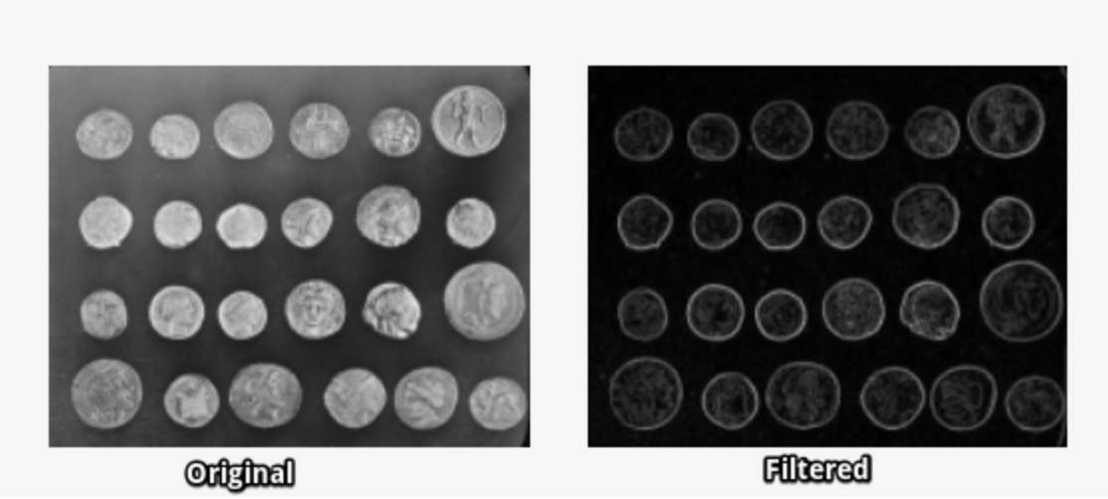
Introduction to Image Processing
Image processing is a way to convert an image to a digital aspect and perform certain functions on it, in order to get an enhanced image or extract other useful information from it.
Libraries Used in Image Processing :-
Scikit-image
OpenCV
SciPy
Pillow
Matplotlib

Slide 4
Why do we need Image processing?
Image processing is most accurately described as a means of translation between a human viewing system and digital imaging devices.
A simple description of image processing refers to digital image processing, eg audio editing and any type of conflict that exists in the image using a digital computer.
Image processing mainly involves the following three steps:
Importing an image with image detection tools;
Exploring and manipulating the image;
An outcome where it can be improved or reported that is built on image analysis.

Slide 5
Steps in Image Processing
Image Acquisition: This word is commonly expected to accept processing, congestion, storage, printing, and display of such images.
Image Enhancement: Image enhancement is a process of switching digital images to more results suitable for display or multiple image analysis.
Image Restoration: The purpose of image restoration techniques is to reduce noise and reclaim the loss of decision.

Slide 6
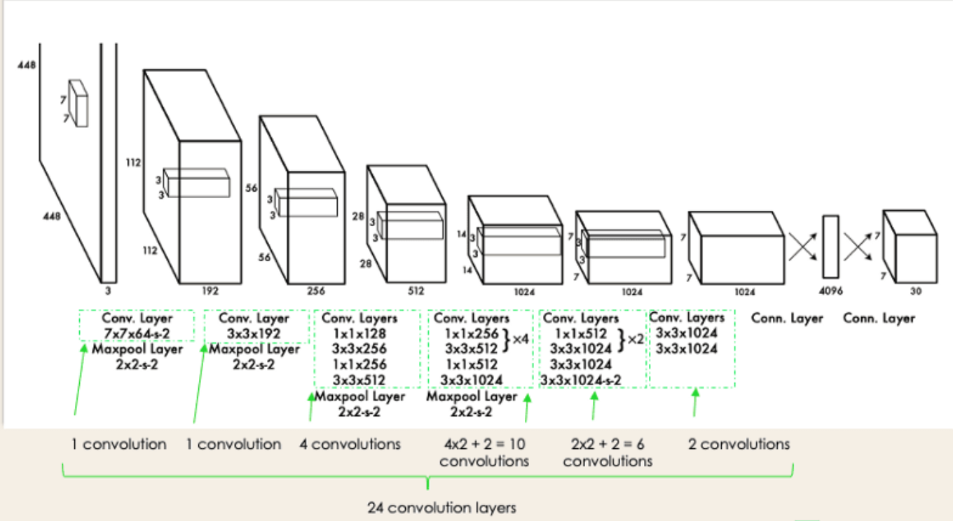
Introduction to YOLO (You Only Look Once)
You Only Look Once (YOLO) is a real-time object detection algorithm
The object detection problem as a regression problem instead of a classification task by spatially separating bounding boxes and associating probabilities to each
of the detected images using a single convolutional neural network (CNN).

Slide 7
What Makes YOLO Popular for Object Detection?
Some of the reasons why YOLO is leading the competition include its:
Speed: It can process images at 45 Frames Per Second (FPS).
Detection accuracy :- very few background errors.
Good generalization:- providing a better generalization for new domains, which makes it great for applications relying on fast and robust object detection.
Open-source:-Making YOLO open-source led the community to constantly improve the model.

Slide 8
YOLO Architecture
It has overall 24 convolutional layers, four max-pooling layers, and two fully connected layers.
The architecture works as follows:
Resizes the input image into 448x448 before going through the convolutional network.
A 1x1 convolution is first applied to reduce the number of channels, which is then followed by a 3x3 convolution to generate a cuboidal output.
The activation function under the hood is ReLU, except for the final layer, which uses a linear activation function.
Some additional techniques, such as batch normalization and dropout, respectively regularize the model and prevent it from overfitting.

Slide 9
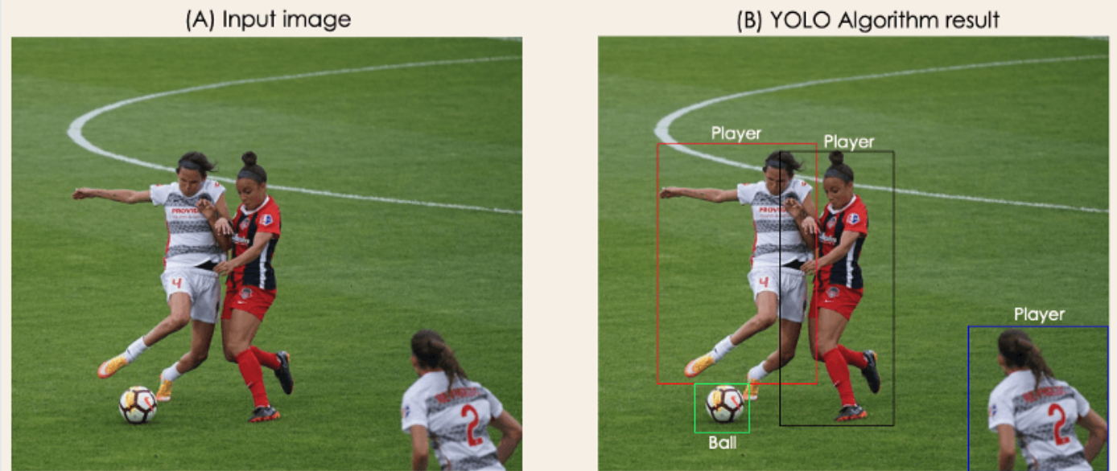
How Does YOLO Object Detection Work?
The algorithm works based on the following four approaches:
Residual blocks
Bounding box regression
Intersection Over Unions or IOU for short
Non-Maximum Suppression.

Slide 10
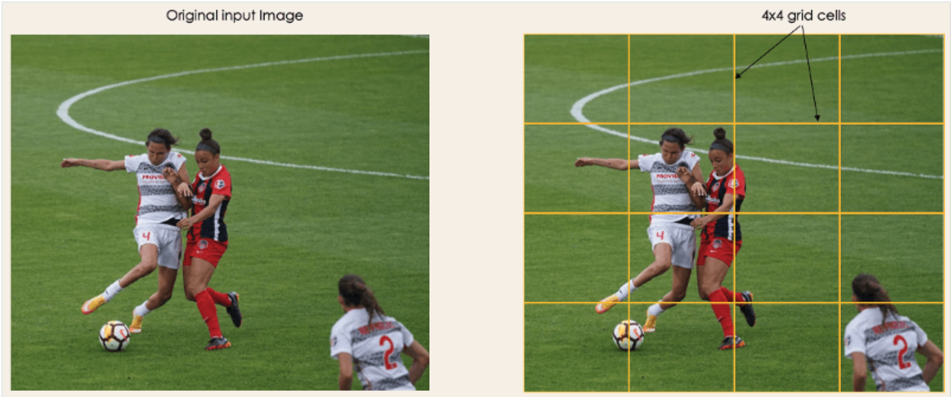
1- Residual blocks
First step starts by dividing the original image (A) into NxN grid cells of equal shape, where N in our case is 4 shown on the image on the right. Each cell in the grid is responsible for localizing and predicting the class of the object that it covers, along with the probability/confidence value.

Slide 11
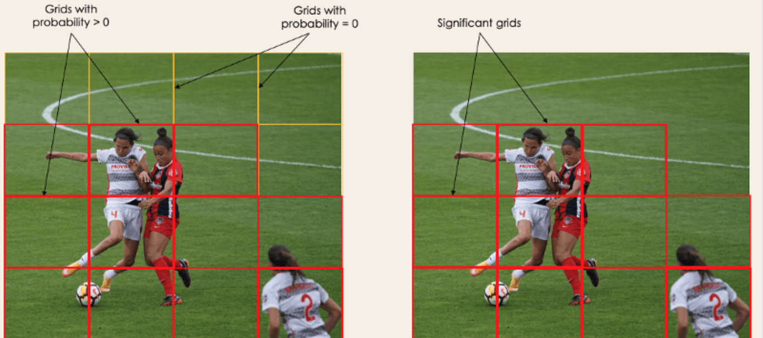
2- Bounding box regression
The next step is to determine the bounding boxes which correspond to rectangles highlighting all the objects in the image.
YOLO determines the attributes of these bounding boxes using a single regression module in the following format, where Y is the final vector representation for each bounding box.
Y = [pc, bx, by, bh, bw, c1, c2]
This is especially important during the training phase of the model.
‘pc’ corresponds to the probability score of the grid containing an object. For instance, all the grids in red will have a probability score higher than zero. The image on the right is the simplified version since the probability of each yellow cell is zero (insignificant).
‘bx, by’ are the x and y coordinates of the centre of the bounding box with respect to the enveloping grid cell.
‘bh, bw’ correspond to the height and the width of the bounding box with respect to the enveloping grid cell.
‘c1 and c2’ correspond to the two classes Player and Ball.

Slide 12
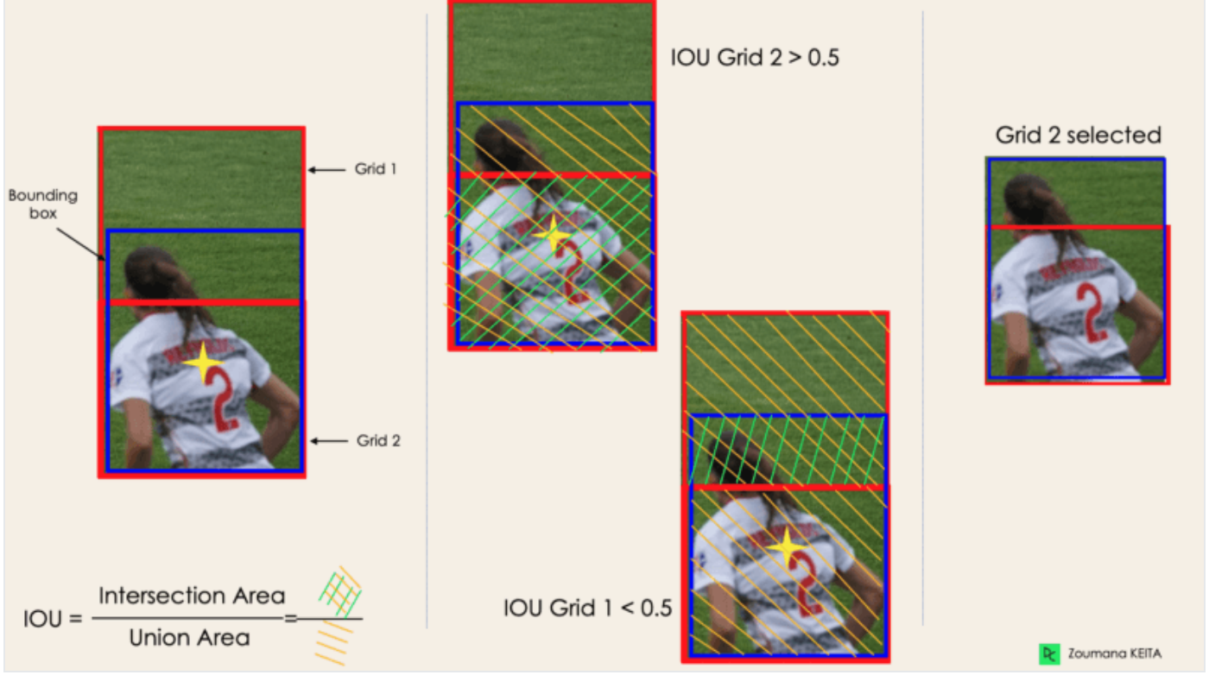
3- Intersection Over Unions or IOU
Most of the time, a single object in an image can have multiple grid box candidates for prediction, even though not all of them are relevant. The goal of the IOU (a value between 0 and 1) is to discard such grid boxes to only keep those that are relevant. Here is the logic behind it:
The user defines its IOU selection threshold, which can be, for instance, 0.5.
Then YOLO computes the IOU of each grid cell which is the Intersection area divided by the Union Area.
Finally, it ignores the prediction of the grid cells having an IOU ≤ threshold and considers those with an IOU > threshold.

Slide 13
4-Non-Max Suppression or NMS
Setting a threshold for the IOU is not always enough because an object can have multiple boxes with IOU beyond the threshold, and leaving all those boxes might include noise. Here is where we can use NMS to keep only the boxes with the highest probability score of detection.

Slide 14
Thank You

